Slide 1

Image Edge Detection of Laplacian Of Gaussian
Bodige madhu - 1274288

Slide 2
Contents
Introduction
Gaussian filter
Laplacian of gaussian filter
Convolution filter

Slide 3
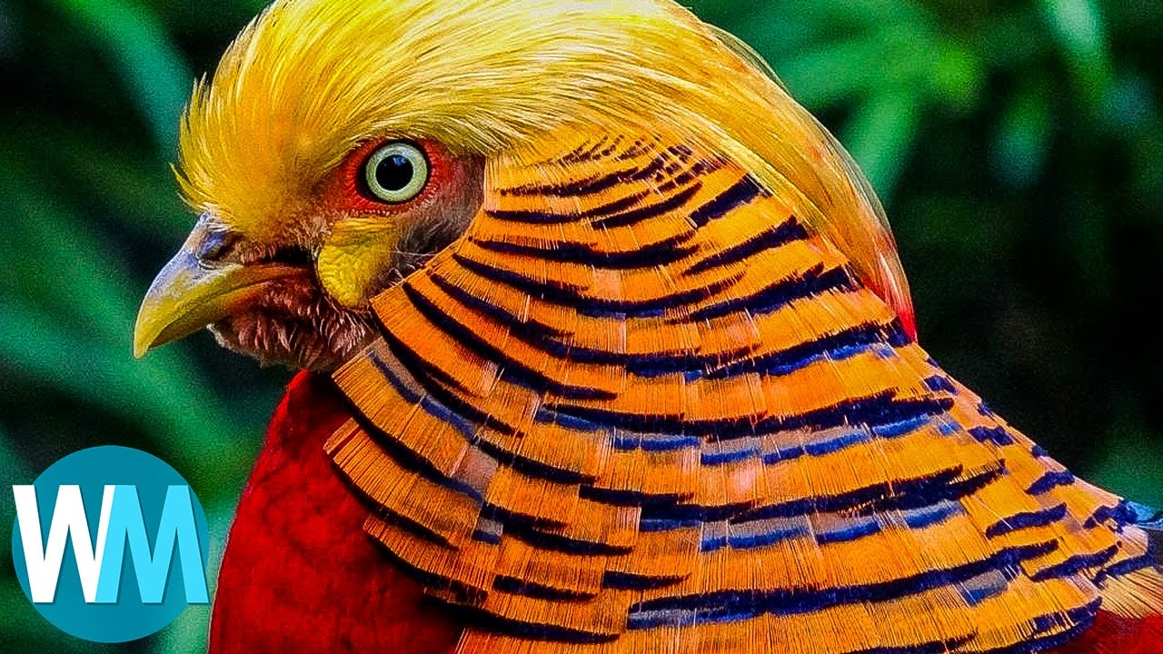
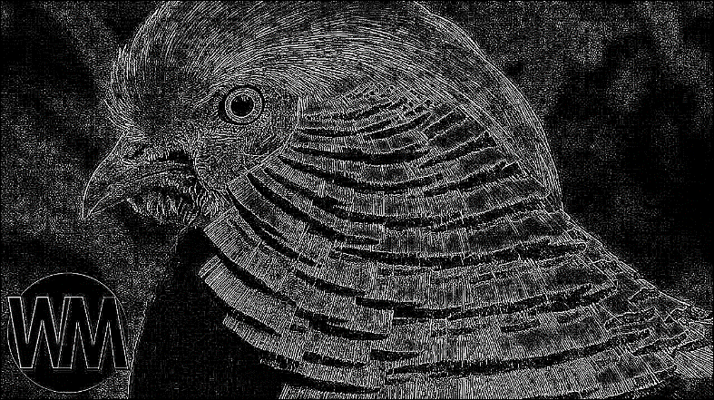
Introduction
EDGE DETECTION
Original Image
finding the boundaries of objects within the images
Look for a neighborhood with strong signs of change
Discontinuities in depth, surface orientation
Changes in material properties
Edge Detected Image

Slide 4
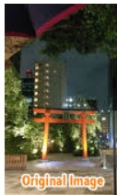
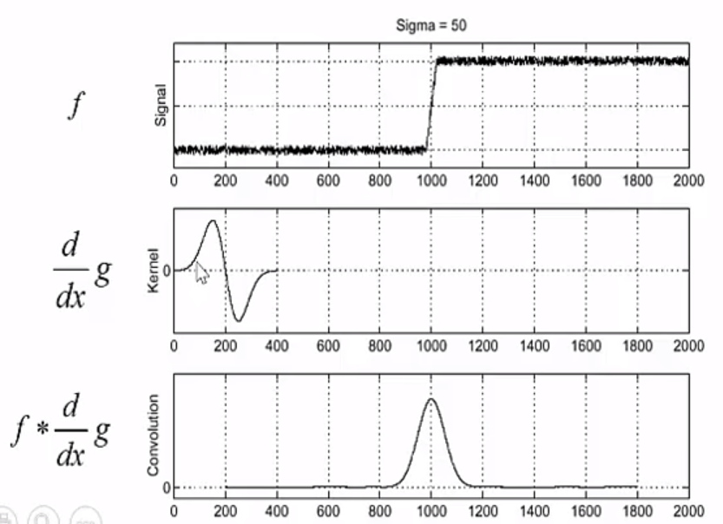
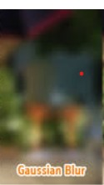
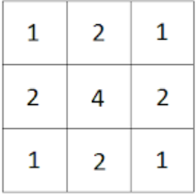
Gaussian filter
It’s used to blur the images and remove the noise
Degree of smoothing can be determined by standard deviation
Input Image
Kernel 3x3
Output Image

Slide 5
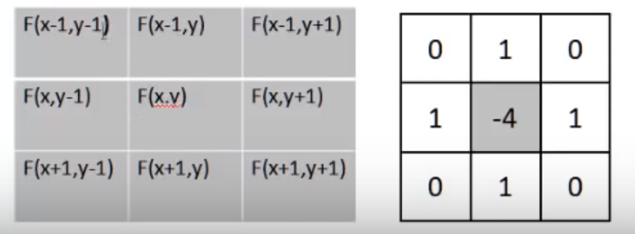
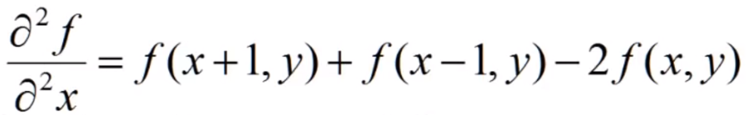
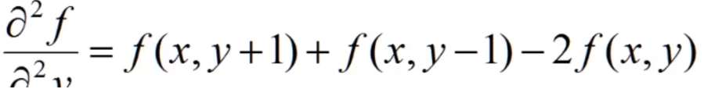
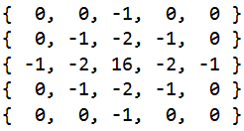
Laplacian of Gaussian filter
Detects the edges of an image and smoothens it by removing the noise
Performs the second derivative to the image to find the zero-crossings
In x-direction
Laplacian Filter Kernel
In y-direction
Laplacian of Gaussian Filter Kernel

Slide 6
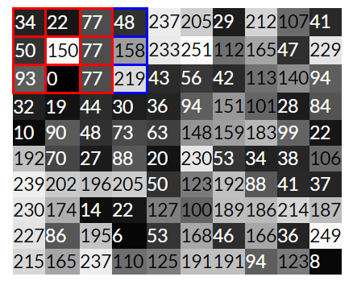
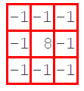
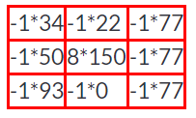
Convolution Filter
Multiplied pixel values
Kernel matrix
Gray scale pixel values of an Image

Slide 7
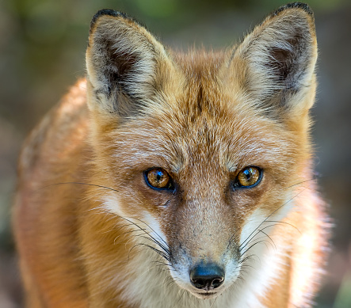
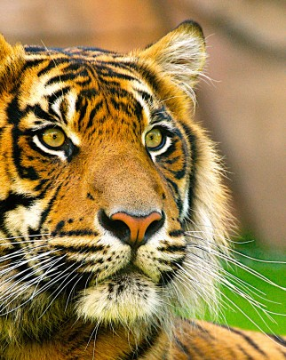
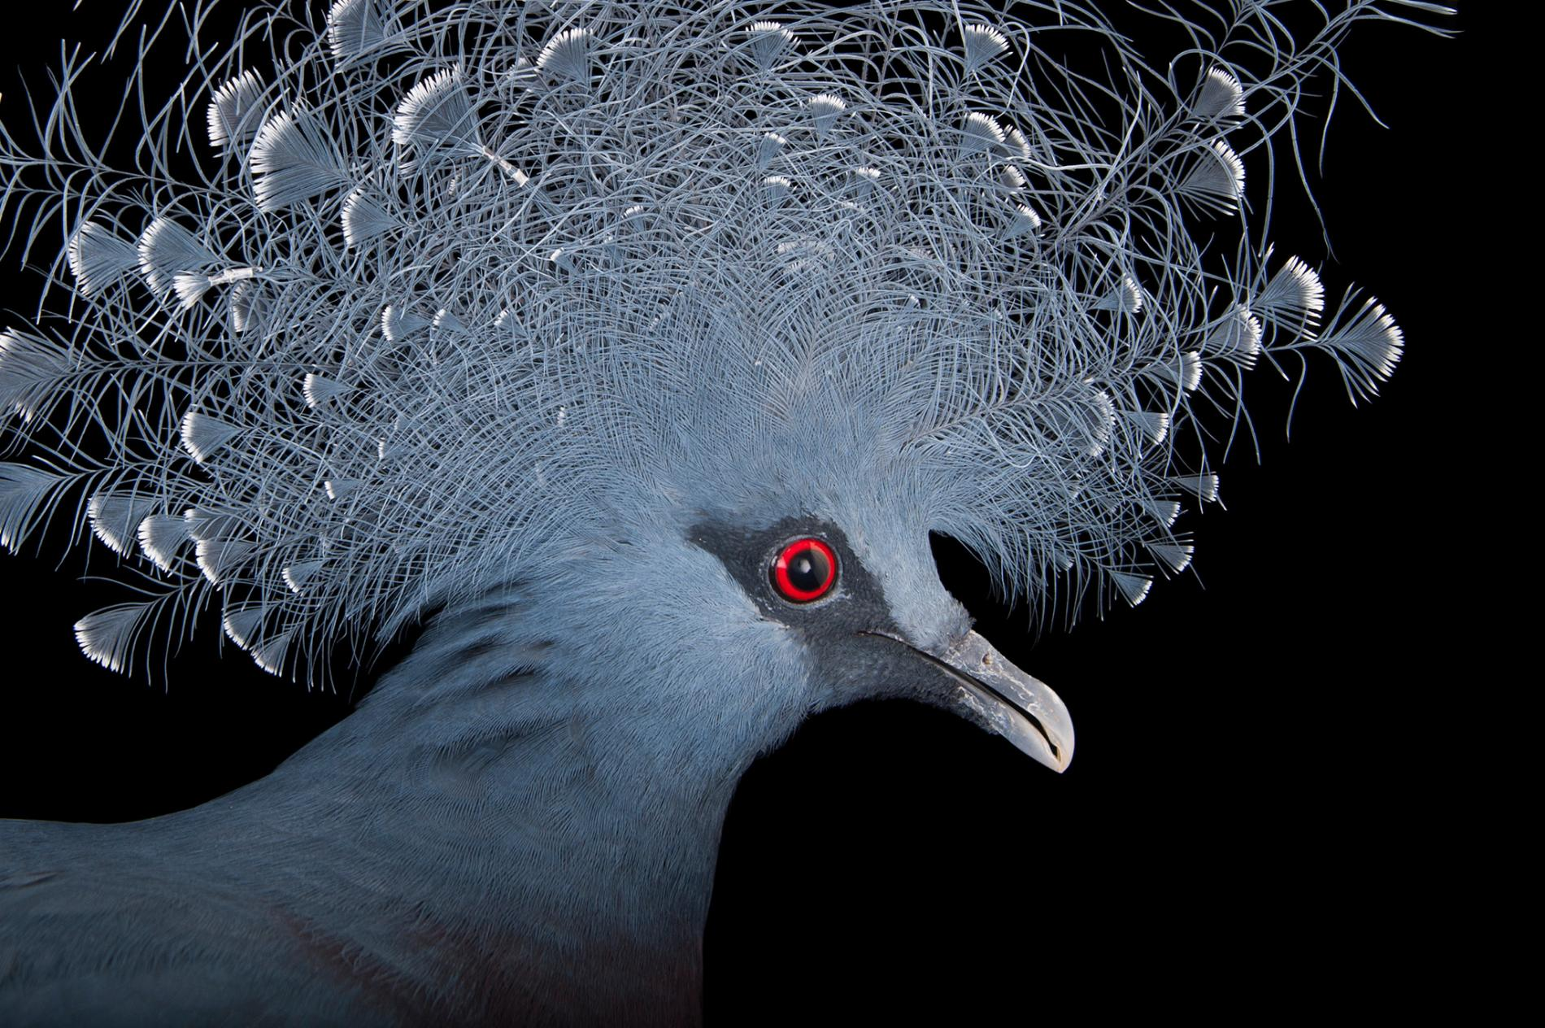
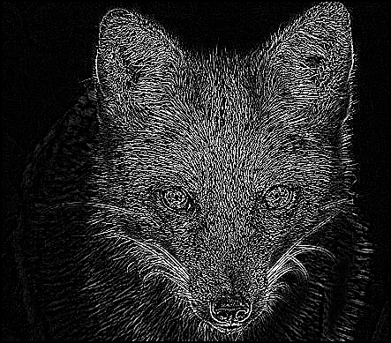
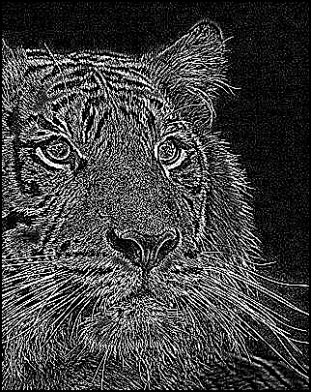
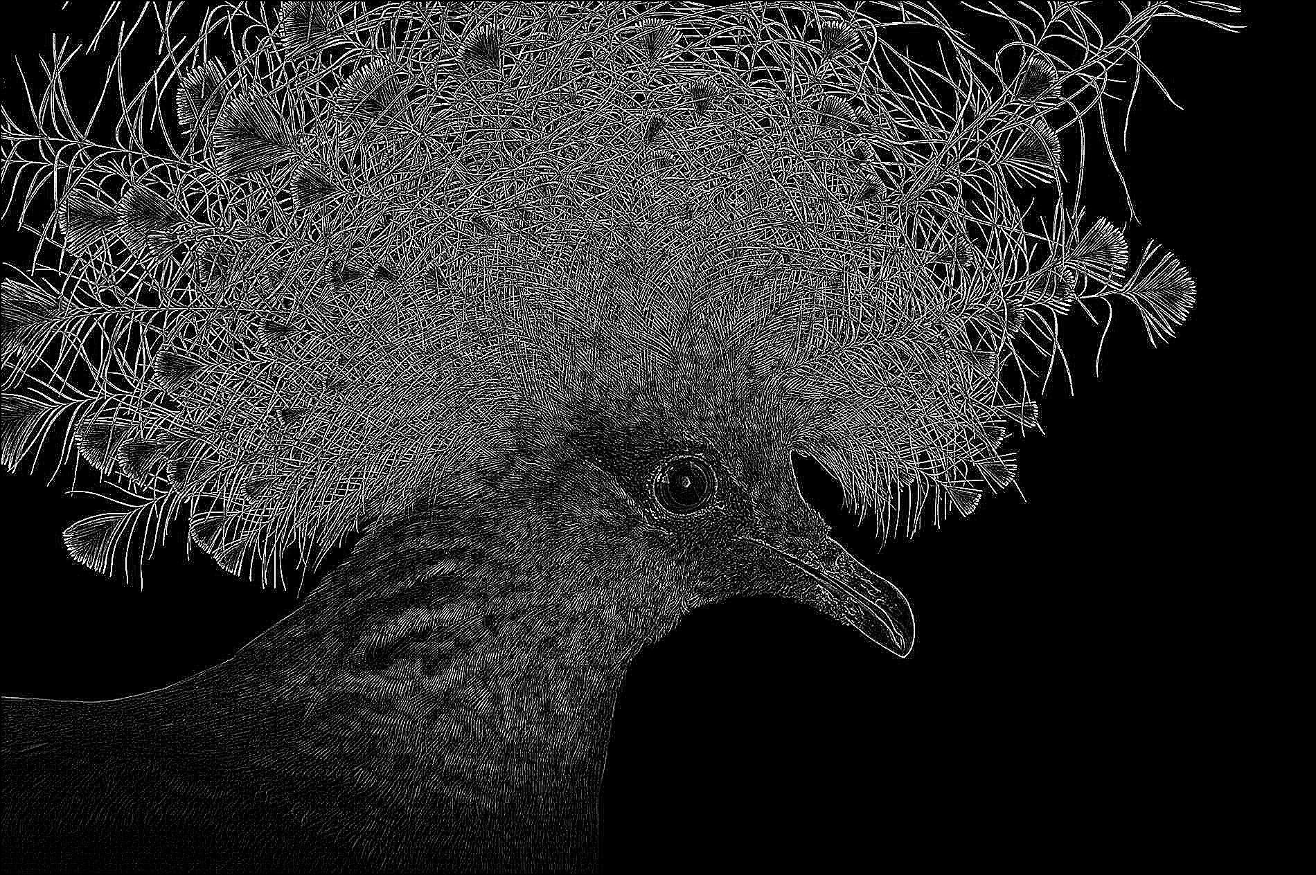
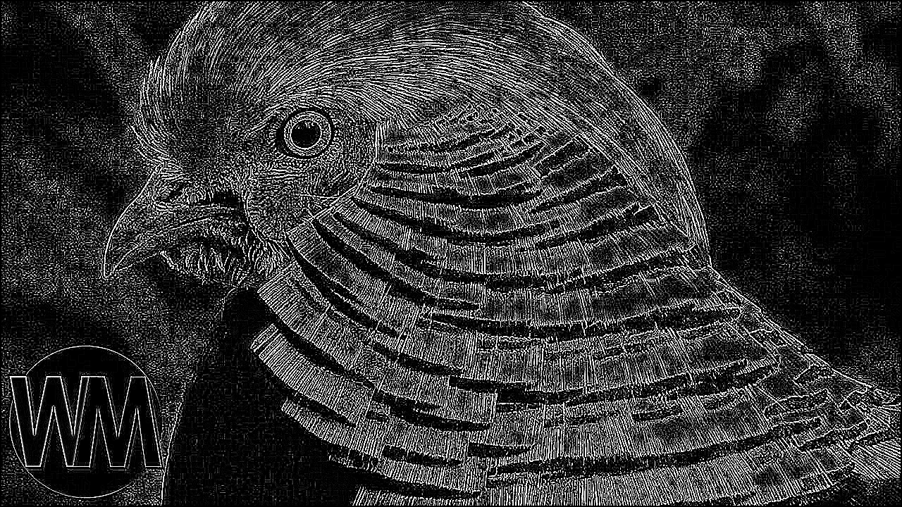
Results
Input Images
Output Images

Slide 8


Discussion AND conclusion
The main idea of the project is to implement the Laplacian of Gaussian filter for Learning API. The project is successfully implemented for Learning API by using Run method. So, for detecting the edges of an image is better to use the Laplacian of Gaussian filter instead of using Laplacian filter because it is very sensitive to noise in which noise is removed in LoG filter.

Slide 9
References
https://homepages.inf.ed.ac.uk/rbf/HIPR2/log.htm
https://academic.mu.edu/phys/matthysd/web226/Lab02.htm
http://fourier.eng.hmc.edu/e161/lectures/gradient/node8.html
http://www.cse.psu.edu/~rtc12/CSE486/lecture11_6pp.pdf

Slide 10




Thank you

